Slide 1

Gas AMR NB-IoT-Based Device Field Test Report
Vishal Panchal
Engineer - IV
System Level Solutions
Plot#32, Zone-D/4, Phase-1, GIDC Estate V.U. Nagar - 388 121, Gujarat, India

Slide 2
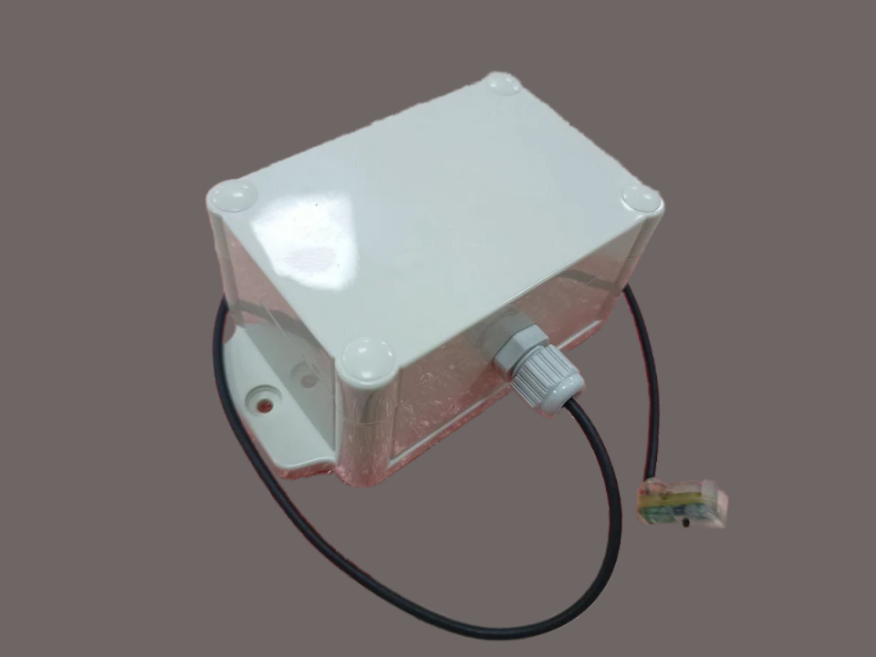
Device Details
Device type: Retrofit Gas AMR
Sensor: Hall effect
Alerts: Magnet Tamper, Switch Tamper, Wire Tamper, Case Tamper and Low Battery
Hardware version: 1.0.
Firmware Version: v01.00.00.00.48711378
Duty Cycle: 1 Hour
RF Technology: LPWAN NB-IoT
Communication protocol: Jio NIDD
Sim Card: Jio NB-IoT SIM
Location: Vadodara , Gujarat
Application Portal: VGL AMR
Portal Link: https://vglamr.in/index.php
Commissioning app: AMR Device Installation - Meter Information
App Link: https://vglamr.in/index1.php
System Level Solutions (India) Pvt. Ltd.

Slide 3
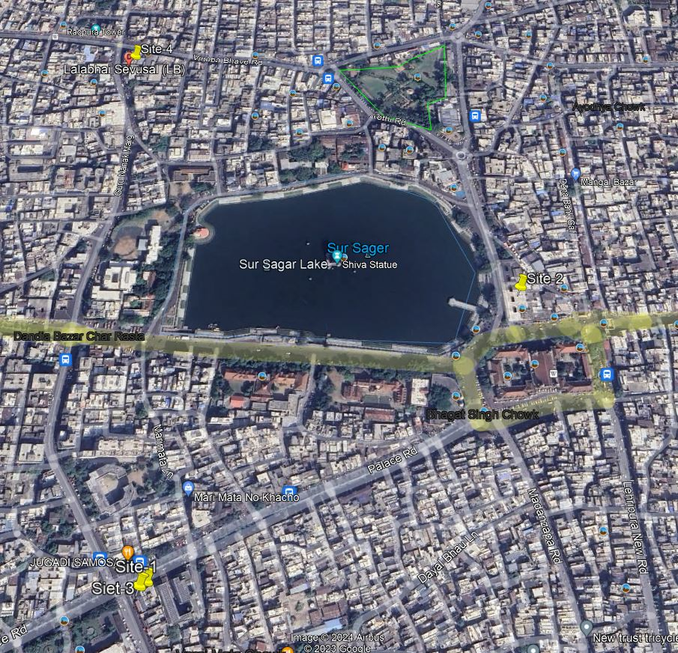

Field site locations
Vadodara, Gujarat
4 Sites
System Level Solutions (India) Pvt. Ltd.

Slide 4
Field site details
Site No | Site Name | Site Address | Lat log.
1 | LAXMI FARSAN HOUSE | Palace Rd, Khanderao Market Char Rasta, Babajipura, Vadodara, Gujarat 390001 | 22.297369111060267, 73.20195485740423
2 | Jai Hind Tea shop | Padmavathi Shopping Center, Mangal Bazar, Mandvi, Vadodara, Gujarat 390001 | 22.30030182792134, 73.20583434786377
3 | Gokaldas Mithaiwala | Palace Rd, Near Market Char Rasta, Sultanpura, Vadodara, Gujarat 390001 | 22.297442867232025, 73.20197039949923
4 | LALABHAI SEVUSAL WALA | Tower Char Rasta, Mandvi, Vadodara, Gujarat 390001 | 22.303508512171934, 73.20127867008785
The four AMR devices are installed for Vadodara Gas Limited's (VGL) commercial gas meters in Vadodara, Gujarat.
Test Duration : 38-45 Days
System Level Solutions (India) Pvt. Ltd.

Slide 5
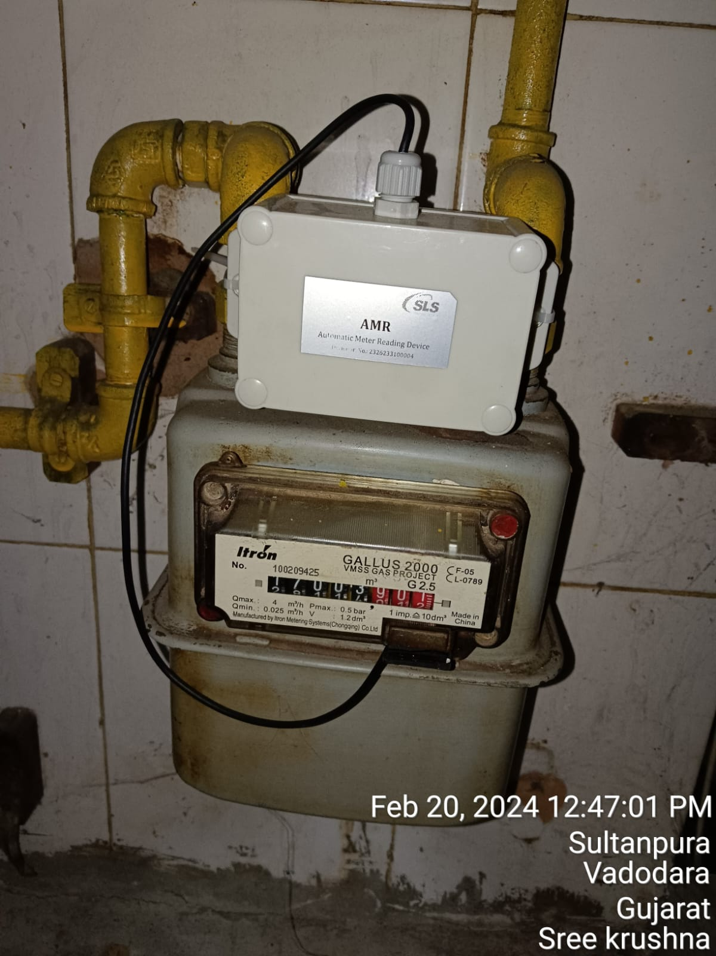
Installation Details
Device Sr No. | Meter Number | Meter Make and Model | Installation date | Site Name
2326233100002 | 100209565 | Itron GALLUS 2000 G2.5 | 06/02/2024 | LAXMI FARSAN HOUSE
2326233100003 | 100424429 | Itron GALLUS 2000 G2.5 | 10/02/2024 | Jai Hind Tea shop
2326233100004 | 100209425 | Itron GALLUS 2000 G2.5 | 10/02/2024 | Gokaldas Mithaiwala
2326233100005 | 150609087 | Itron GALLUS G2.5 | 06/02/2024 | LALABHAI SEVUSAL WALA
Test Duration: Devices 2, 3, and 5 have run times of 42 days, whereas Device 4 has a run time of 38 days (w.r.t 19/03/2024).
System Level Solutions (India) Pvt. Ltd.

Slide 6
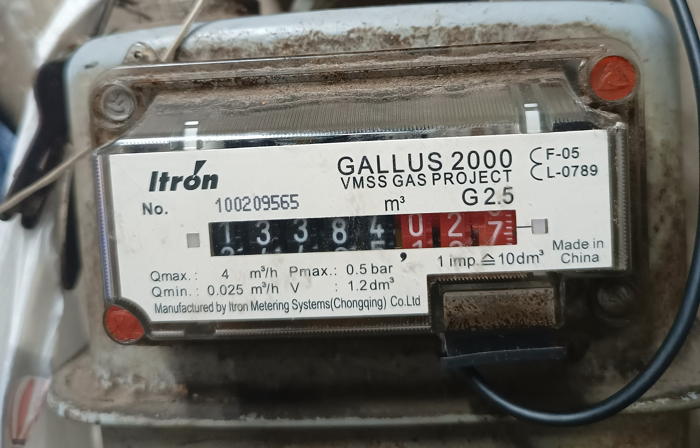
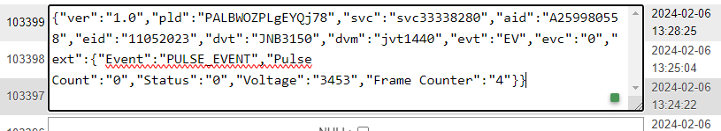
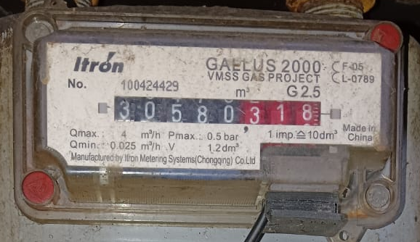
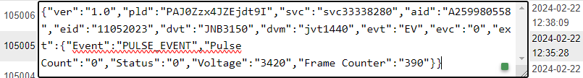
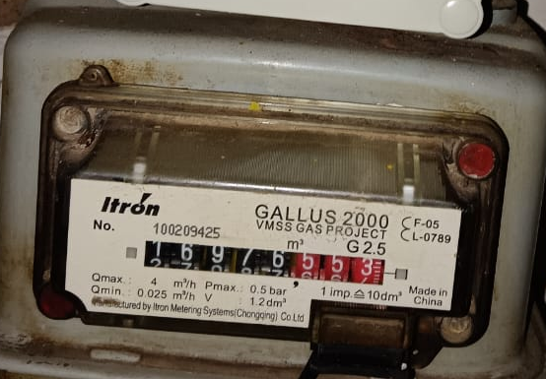
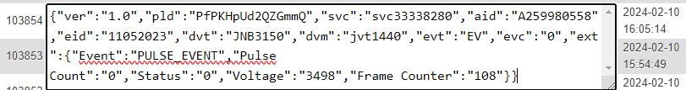
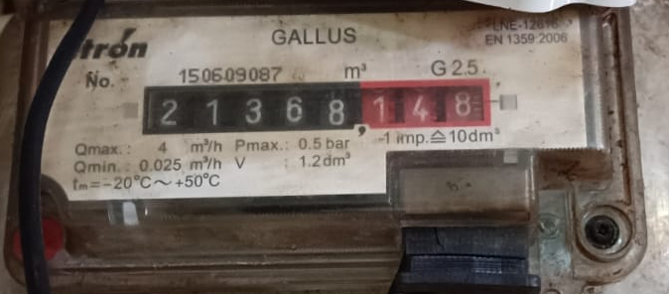
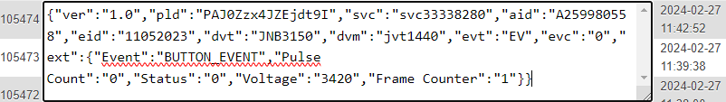
Initial Reading Details
Meter Initial count |  |  | AMR Initial count
Meter Number | Meter Reading | Capture Image | Device Sr No. | AMR Reading | Capture Image
100209565 | 13384.02 |  | 2326233100002 | 0
100424429 | 30580.31 |  | 2326233100003 | 0
100209425 | 16976.55 |  | 2326233100004 | 0
150609087 | 21431.71 |  | 2326233100005 | 0
System Level Solutions (India) Pvt. Ltd.

Slide 7
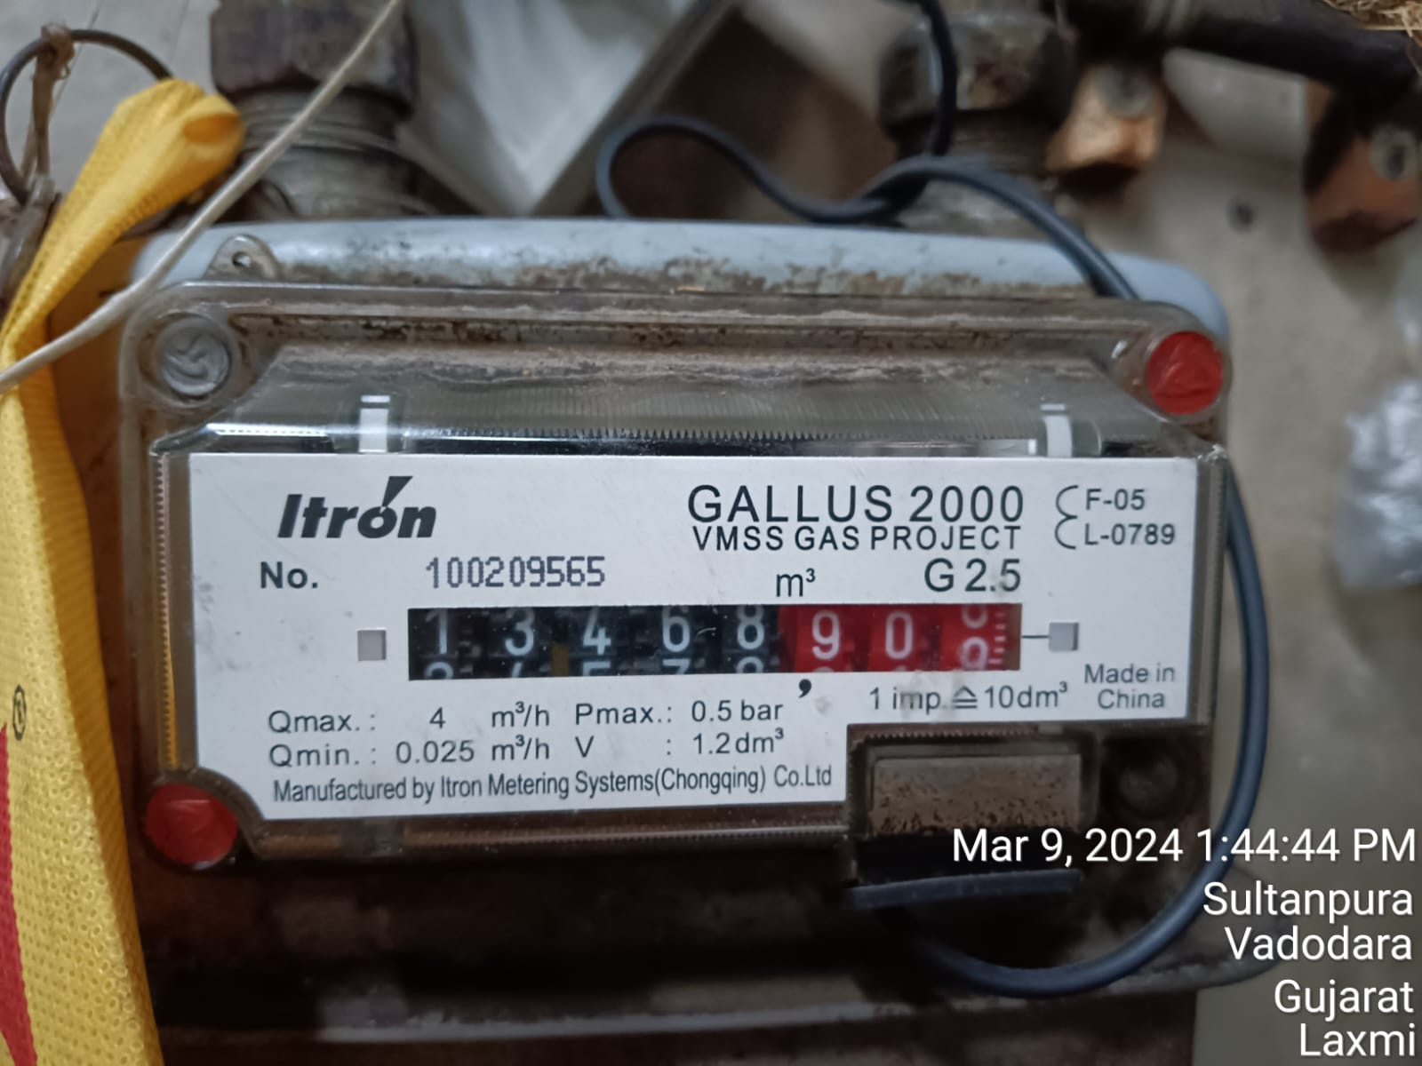
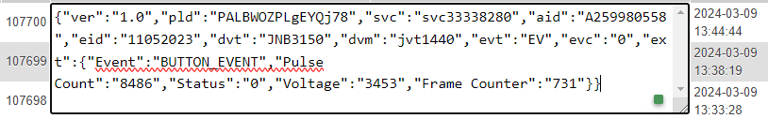
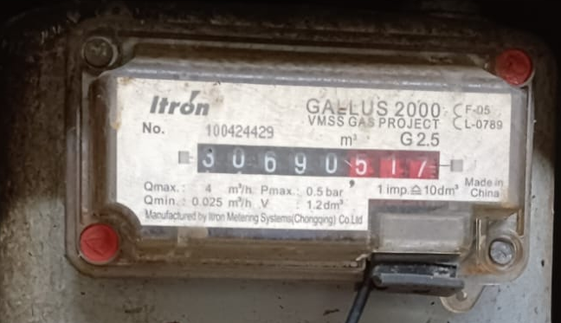
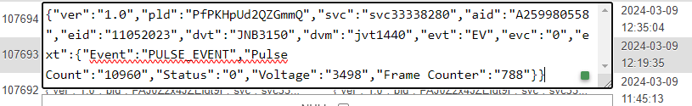
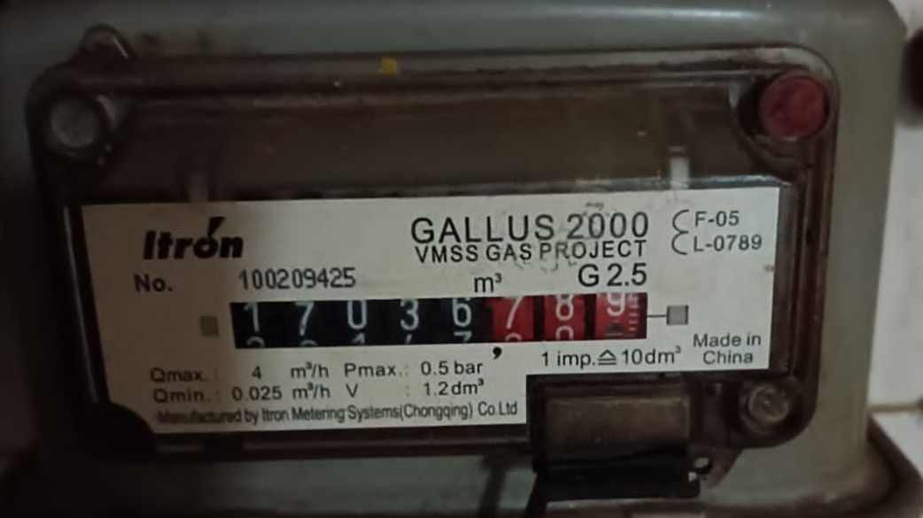
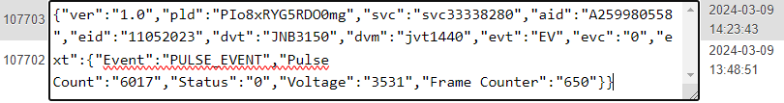
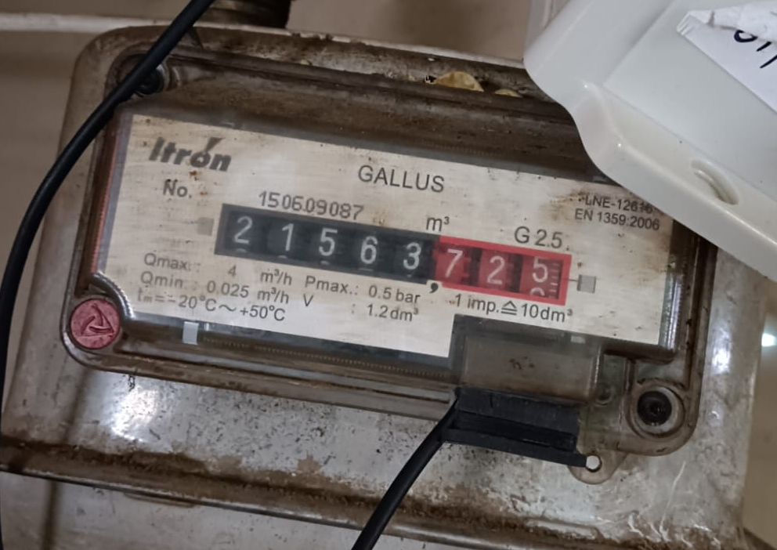
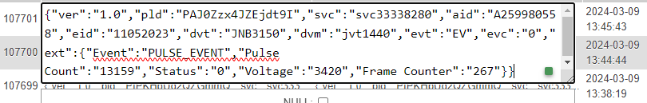
Latest Reading Details
Meter latest count |  |  | AMR latest count
Meter Number | Meter Reading | Capture Image | Device Sr No. | AMR Reading | Capture Image
100209565 | 13468.90 |  | 2326233100002 | 8486
100424429 | 30690.51 |  | 2326233100003 | 11019
100209425 | 17036.78 |  | 2326233100004 | 6017
150609087 | 21563.72 |  | 2326233100005 | 13159
System Level Solutions (India) Pvt. Ltd.

Slide 8
Consumption Matching sheet
Meter Pulse count |  |  | AMR Device Pulse count |  |  | Consumption by Meter | Consumption by AMR | Reading Difference | Remarks
Meter Number | Initial | Latest | Device Sr No. | Initial | Latest
100209565 | 13384.02 | 13468.90 | 2326233100002 | 0 | 8486 | 84.88 | 8486 | 0.02 | due to the captured image of the meter in running condition, and the captured image and latest uplink have a few minute time differences, which cause consumption differences.
100424429 | 30580.31 | 30690.51 | 2326233100003 | 0 | 11019 | 110.2 | 110.19 | 0.01
100209425 | 16976.55 | 17036.78 | 2326233100004 | 0 | 6017 | 60.23 | 60.17 | 0.06
150609087 | 21431.71 | 21563.72 | 2326233100005 | 0 | 13159 | 132.01 | 131.59 | 0.42
System Level Solutions (India) Pvt. Ltd.

Slide 9
Other Alerts and Indications
Device Run time and D2C message (18/03/2024)
SR NO | Device ID | PLM ID | Installation date | Installation time | Run time in Hours | Number of D2C message | Missed D2C message | Remarks
1 | 2326233100002 | PALBWOZPLgEYQj78 | 06/02/2024 | 13:28:25 | 988 | 932 | 4
2 | 2326233100005 | PAJ0Zzx4JZEjdt9I | 06/02/2024 | 12:37:45 | 1000 | 987 | 3
3 | 2326233100004 | PIo8xRYG5RDO0mg | 10/02/2024 | 16:46:49 | 882 | 854 | 4
4 | 2326233100003 | PfPKHpUd2QZGmmQ | 10/02/2024 | 16:05:14 | 888 | 1005 | 4 | Device installed on 6th fab, Re installed on 10th Fab
System Level Solutions (India) Pvt. Ltd.

Slide 10
Device Tamper Alert status
SR NO | Device ID | PLM ID | Tamper status | Magnet Tamper | Switch Tamper | Wire Tamper | Case Tamper | Remarks
1 | 2326233100002 | PALBWOZPLgEYQj78 | 0 | 0 | 0 | 0 | 0
2 | 2326233100005 | PAJ0Zzx4JZEjdt9I | 0 | 0 | 0 | 0 | 0
3 | 2326233100004 | PIo8xRYG5RDO0mg | 0 | 0 | 0 | 0 | 0
4 | 2326233100003 | PfPKHpUd2QZGmmQ | 1 | 0 | 1 | 0 | 0 | Switch tamper observed due to device removed for smart gas meter installation on (07/02/2024)
Device Battery Status (18/03/2024)
SR NO | Device ID | PLM ID | Initial Battery voltage | Latest Battery voltage | Difference Battery voltage | Remarks
1 | 2326233100002 | PALBWOZPLgEYQj78 | 3.453 | 3.453 | 0
2 | 2326233100005 | PAJ0Zzx4JZEjdt9I | 3.420 | 3.420 | 0
3 | 2326233100004 | PIo8xRYG5RDO0mg | 3.531 | 3.531 | 0
4 | 2326233100003 | PfPKHpUd2QZGmmQ | 3.498 | 3.498 | 0
System Level Solutions (India) Pvt. Ltd.

Slide 11
Conclusive points
Device Performance
Devices can read meter consumption properly.
Devices can send uplink every hour successfully with an updated pulse count, battery status, and tamper status in a proper manner.
Device can alert all supportive tampers.
Devices can receive a downlink to set the device's configuration purposes after sending an uplink.
Devices can capture logs for debugging purposes, which will be shown after a complete field test.
Devices can send an instant uplink for a low battery alert, and when a soft reset occurs, devices also record the soft reset count in the device.
System Level Solutions (India) Pvt. Ltd.

Slide 12
Conclusive points
NB-IoT Network Connectivity
D2C Communication: D2C communication is communicated properly for all four installed devices in a specific location.
C2D Communication: D2C communication is communicated properly for all four installed devices in a specific location.
At the time of installation, it was observed that there was a network connectivity issue in the meter installed location due to the meter location inside the kitchen of the one site. device can communicate outside of the kitchen. site details as shown in the below table.
Network related few logs listed below (Note: The below four numbers will be analyzed and shown after device collection from field.)
Number of times Network registration
number of times the default app activation was requested
Number of times a specific app activation was requested
Number of times fail to receive acknowledgement for the D2C message.
Site Name | Site Address | Lat log.
Krishnashray Hospita | 852X+WWV, Santhavasaht, Raopura, Mandvi, Vadodara, Gujarat 390001 | 22.302372071495896, 73.19983081641823
System Level Solutions (India) Pvt. Ltd.

Slide 13
Conclusive points
Application Portal
Able to show an updated pulse count, tamper status, battery status, and last communication properly.
Not able to show particular D2C uplink messages that contain raw data like message ID, payload (JSON), event type, and frame counter. Those details are necessary for test analysis purposes.
The present results and messages are taken from the raw PHP portal.
The requested feature for the portal is not ready, which is listed below.
In the dashboard are required things like active device, faulty device, tamper alert, low battery alert, etc.
In the device profile are required things like gas consumption, total uplink, missed packets and are shown in graphical format.
In the device profile battery status, tamper status
In the device profile, the C2D section implements sending a C2D downlink for device configuration purposes.
System Level Solutions (India) Pvt. Ltd.

Slide 14
Conclusive points
Mobile Commissioning app
Able to manually enter details such as device ID, meter ID, and meter initial count reding for portal entry.
Able to capture multiple images using a smartphone camera in the app.
Able to update details on the application portal that was entered in the app
The requested correction in app are still pending to correct, which is listed below.
meter readings must have numerical data entry only
Latitude and longitude should not be editable
After selection of device ID and meter ID, other paired data should be shown on the mobile app.
System Level Solutions (India) Pvt. Ltd.

Slide 15
Thank you
System Level Solutions (India) Pvt. Ltd.

